Slide 1

Final project
AML 2203 - Advanced python ai and ml tools
Group Members
1. Bibek Shah Shankhar (C0835648)
2. Tika Thapa (C0832724)
3. Rajasekhar Katta (C0833766)
4. Hukamdeep Singh(C0834020)

Slide 2
PROJECT WORKFLOW
PROJECT 1A ( FILE HANDLING IN PYTHON)
PROJECT 1B (DATABASE INTERACTION)
PROJECT 2B ( TEXTUAL DATA HANDLING WITH NLTK)
PROJECT 2D (IMPLEMENT FEATURE EXTRACTION USING PCA)
PROJECT 3A (IMPLEMENT LINEAR REGRESSION)
PROJECT 3B (PERFORM LINEAR REGRESSION )

Slide 3
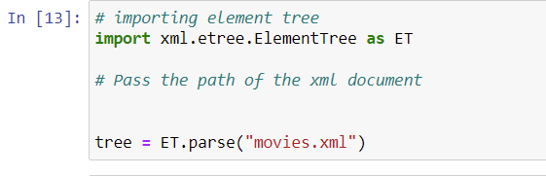
Project 1a – file handling with python
We used The xml.etree.ElementTree module to implements a simple and efficient API for parsing and creating XML data. I used the movies.xml dataset to practice.

Slide 4
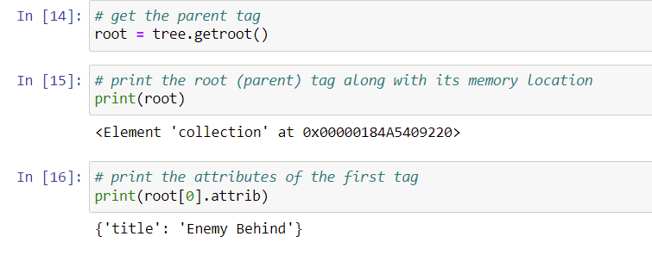
After that we get the parent tag and print the parent tag along with its memory location.

Slide 5
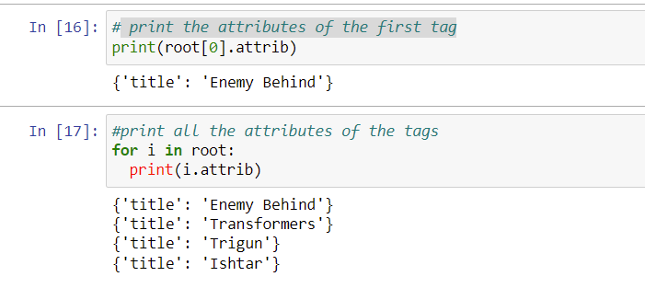
print the attributes of the first tag and all the attributes of the tags

Slide 6
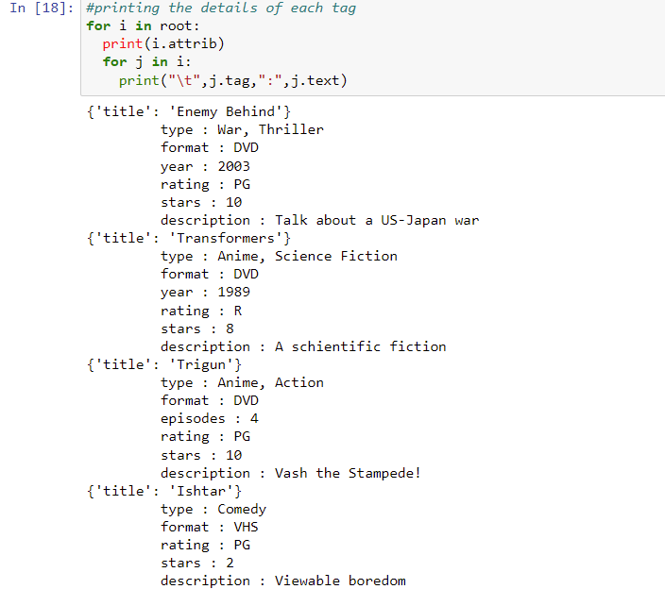
Printing the details of each tag.

Slide 7
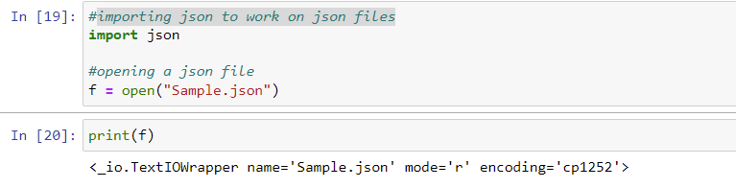
importing json to work on json files and opening a json file

Slide 8
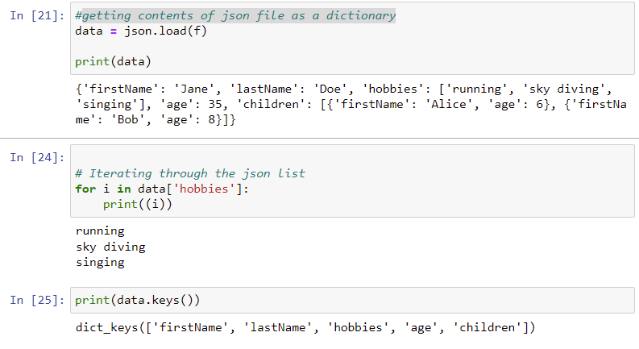
getting contents of json file as a dictionary

Slide 9
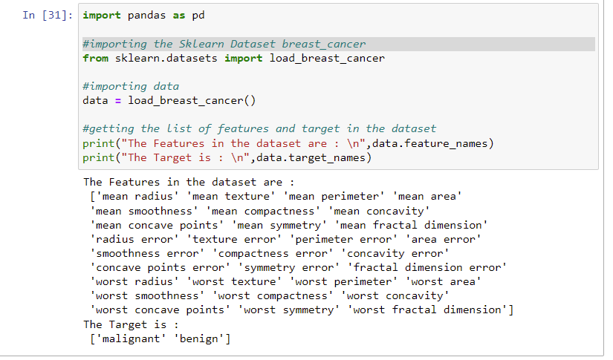
importing the Sklearn Dataset breast_cancer and listing the features and target

Slide 10
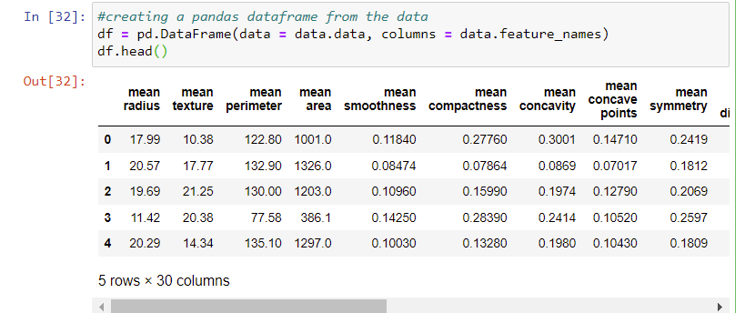
creating a pandas dataframe from the data

Slide 11

Exporting the Data_set so obtained in a JSON file

Slide 12
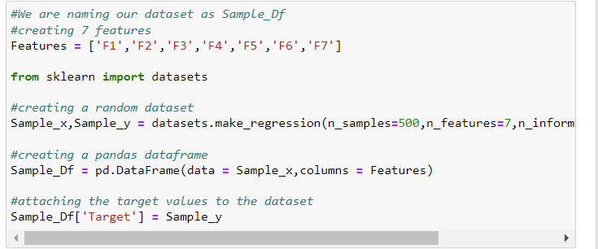
Make a regression dataset (500) with 7 features while having 4 informative features and store them on disk in a csv file

Slide 13
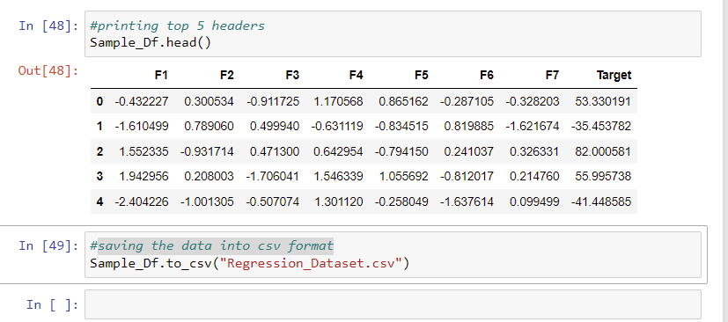
saving the data into csv format

Slide 14
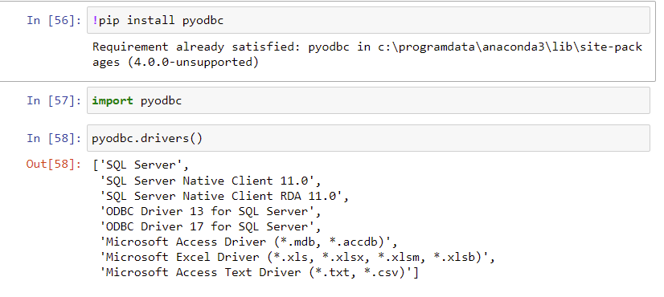
PROJECT 1B (DATABASE INTERACTION)
pyodbc is an open source Python module that provides access to ODBC databases. pyodbc implements the Python DB API 2.0 specification.
Installing pyodbc and importing pyodbc

Slide 15
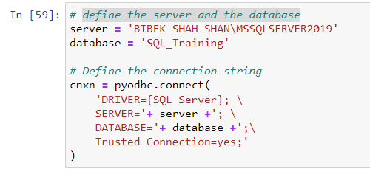
define the server and the database

Slide 16
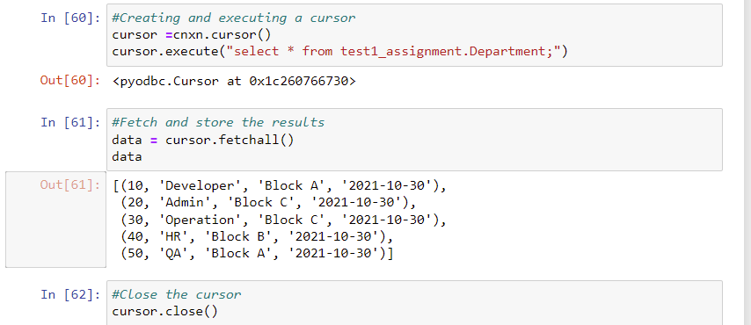
Creating and executing a cursor and fetching the data and storing the results

Slide 17
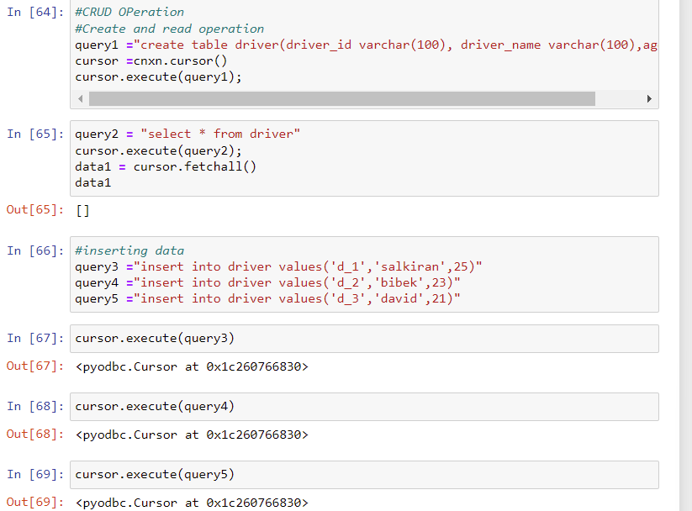
CRUD OPERATION
CREATE READ UPDATE AND DELETE
Inserting the data and reading the data

Slide 18
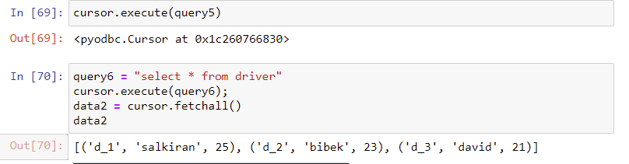
Reading the data

Slide 19
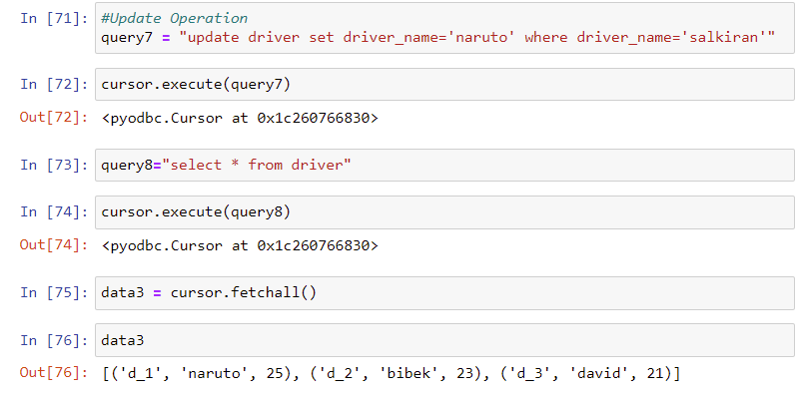
Updating the data

Slide 20
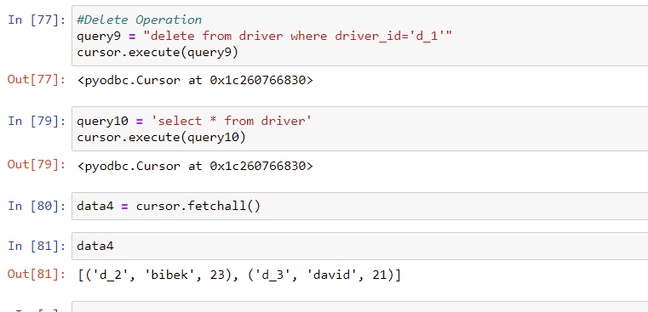
Deleting the data

Slide 21
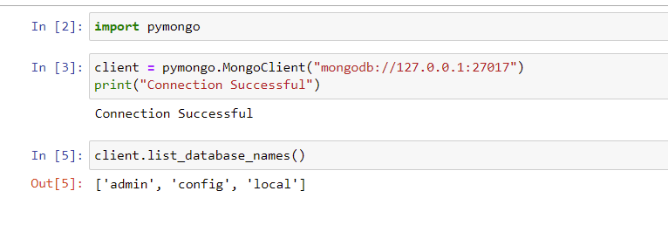
Connection to mongodb using python
PyMongo is a Python distribution containing tools for working with MongoDB, and is the recommended way to work with MongoDB from Python.
Importing pymongo and establishing connection

Slide 22
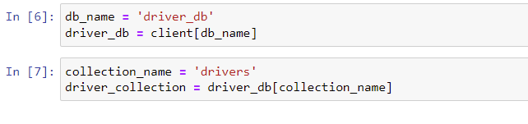
Creating the database and collection using pymongo

Slide 23
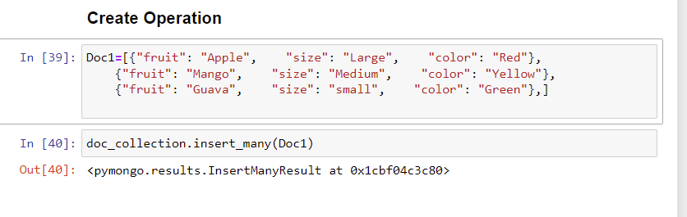
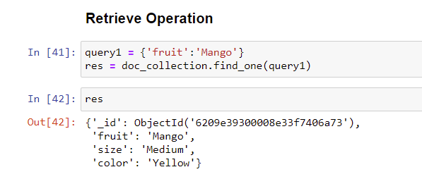
CRUD Operation

Slide 24
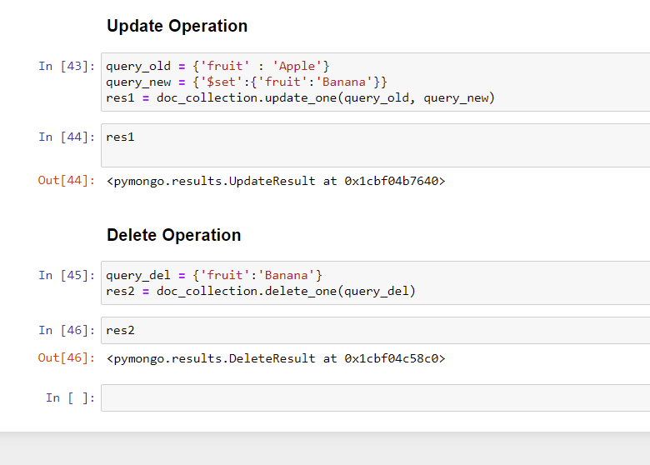

Slide 25
PROJECT 2B ( TEXTUAL DATA HANDLING WITH NLTK)
We have a Python tool called NLTK that we use to pre-process the text (Natural Language processing Toolkit). It includes all of the processes necessary for data processing.
We utilise a Python programme called NLTK to pre-process the text (Natural Language processing Toolkit). It encompasses all of the steps involved in data processing.

Slide 26
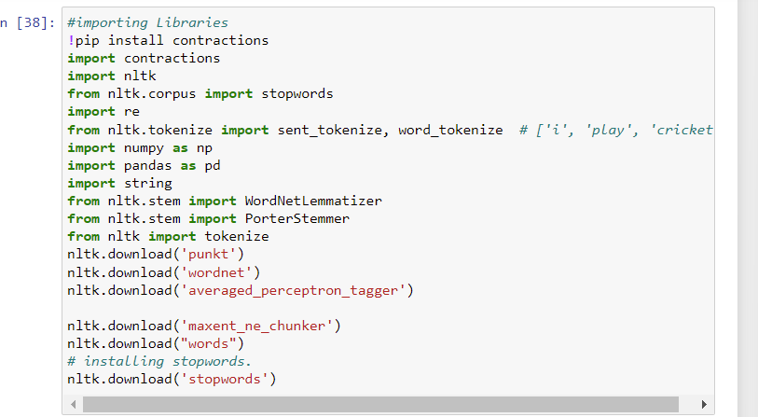
Importing necessary libraries

Slide 27
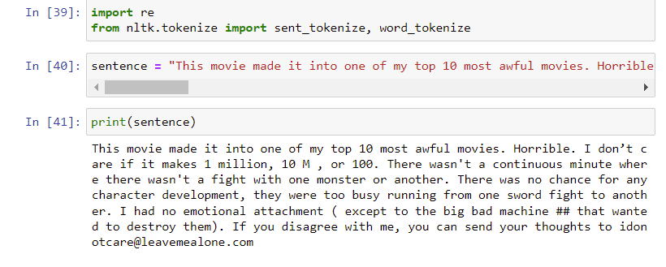
Sentence to analyze

Slide 28
Methods used for preprocessing dataa
Remove Contractions
Remove Special Characters
Tokenization
Removing stop words
Stemming
Lemmatization

Slide 29
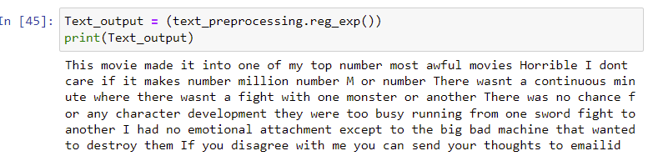
Text Preprocessing

Slide 30
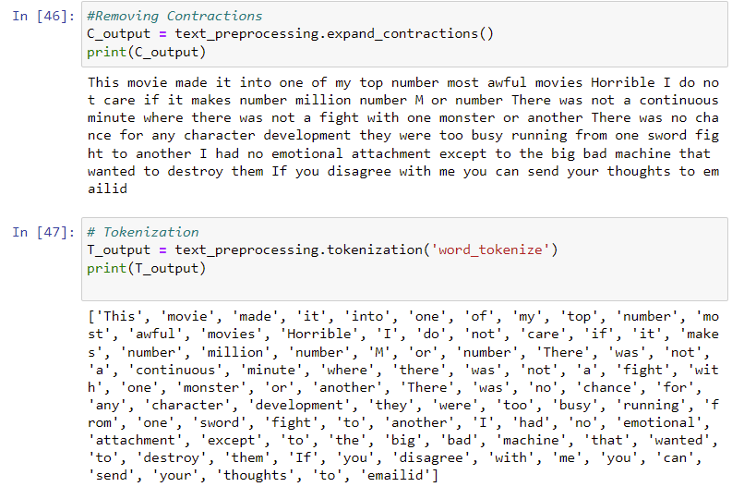
Removing Contradictions and tokenizations

Slide 31
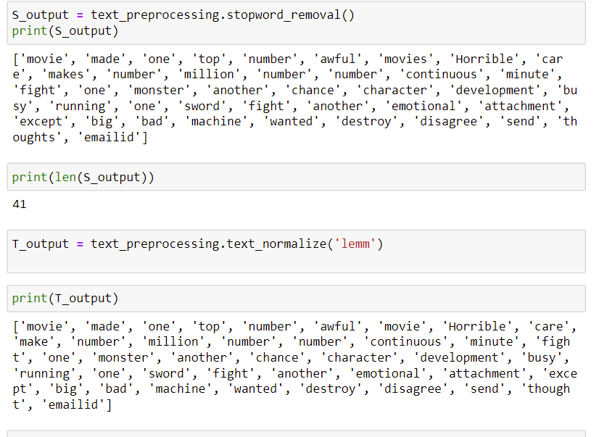
Stopword removal and text normalixations

Slide 32
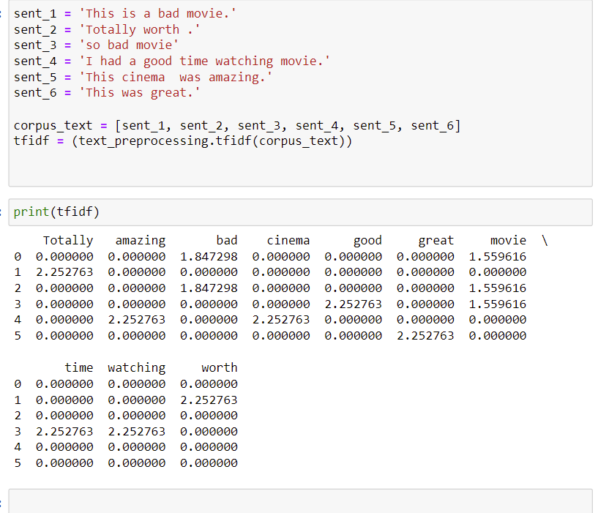

Slide 33
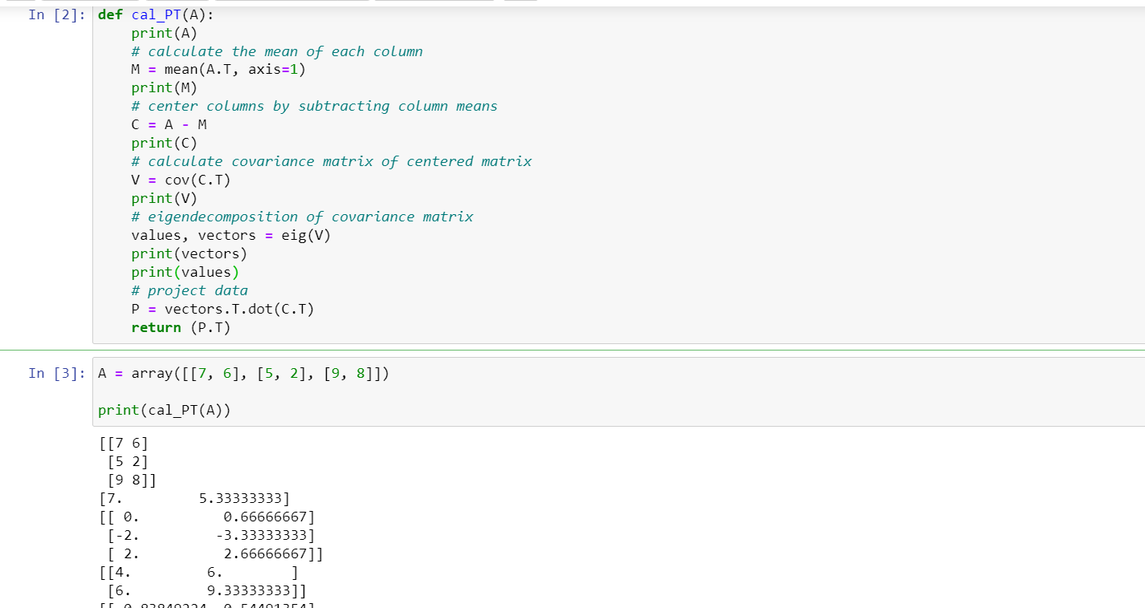
Project 2d •Implement Feature extraction using PCA with the following data. •array([[7, 6], [5, 2], [9, 8]])

Slide 34
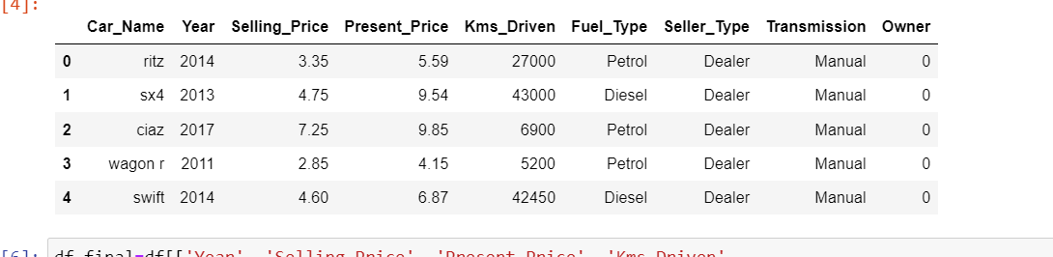
3A •Implement Linear regression on a continuous dataset from Kaggle.
Car data set

Slide 35
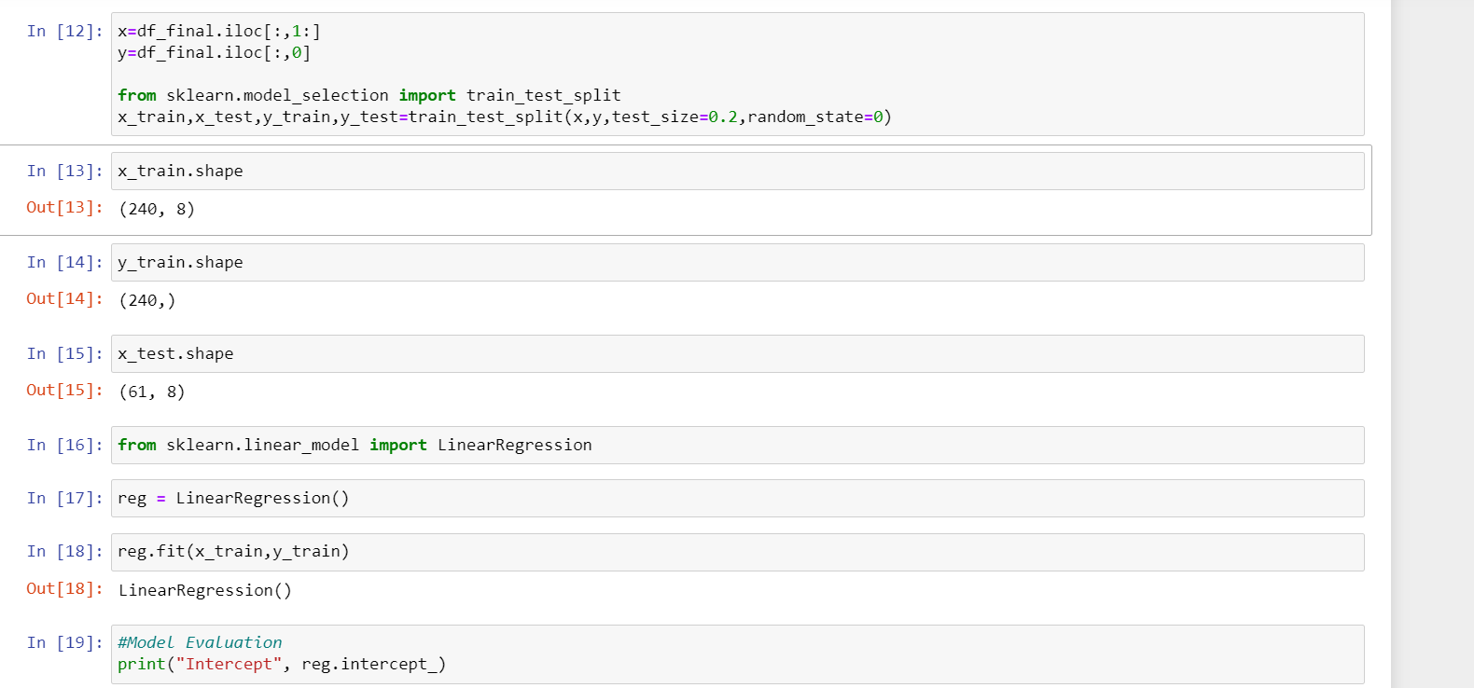
Splitting data and applying linear regression Model

Slide 36
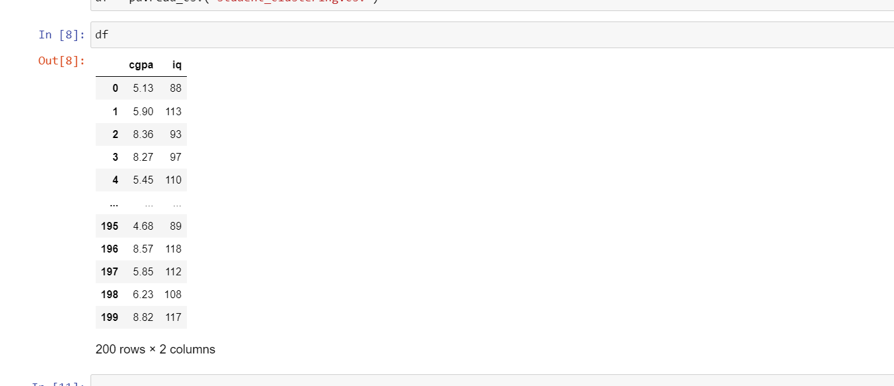
3B Perform Linear regression on any dataset of your choice and visualize the results.
Data Set

Slide 37
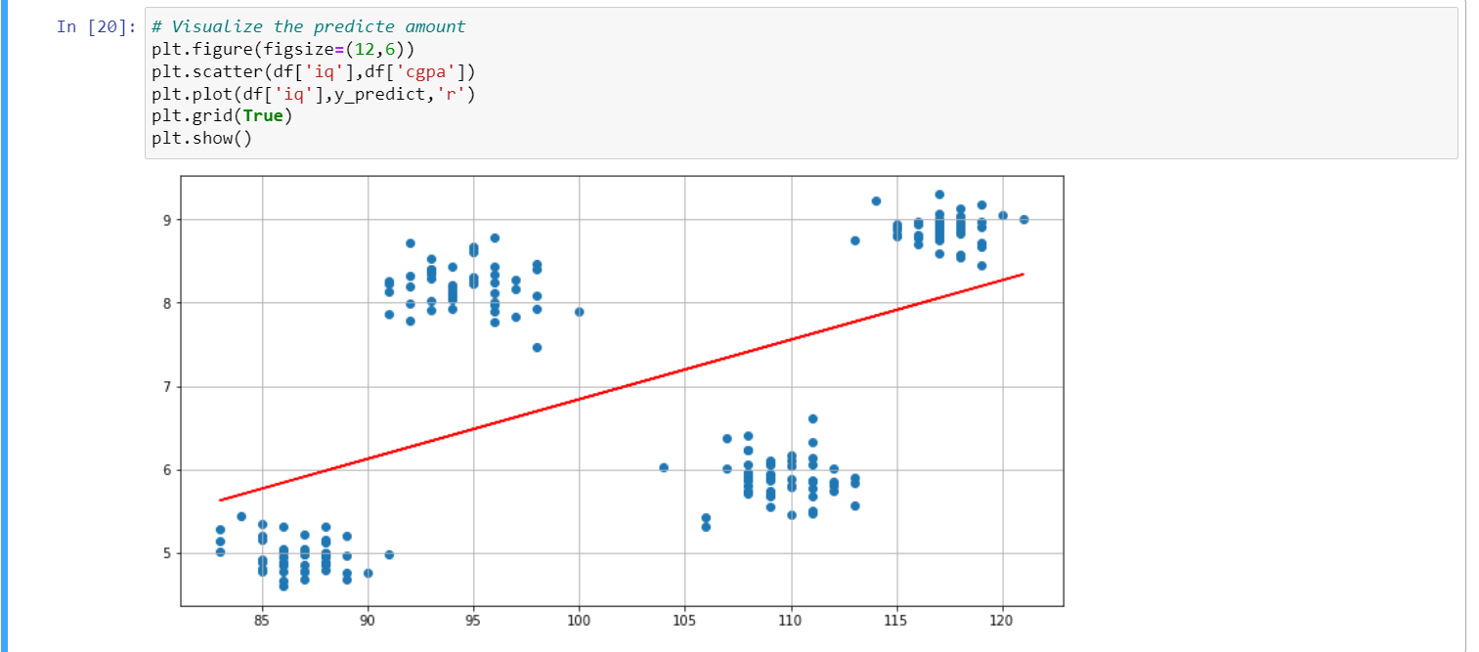
Visualizing Result after applying linear regression

